Slide 1

BASIC SOCIAL MEDIA PLATFORM
Yahya Çakıcı 22050951010
Emirhan Tıpırdamaz 21050911015

Slide 2
Project Description:
This project aims to simulate a basic social media platform system. It provides users with functions such as registering, logging in, changing account information, adding/removing friends, viewing friend list. Users' account information and friend lists are stored in a text file named "P_account_details.txt".
Project Modules:
Welcoming , Customer_Menu , Sign_in , Registration , Change_Username , Change_Password , Add_Friend , Del_Friend, Show_Friend_List
These modules are used to perform the different functions of the user management system and together they form the basis of the project.

Slide 3
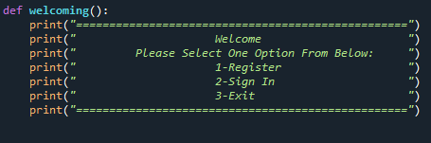
welcoming():
Displays a welcome message to the user.
Provides a menu with options for registration, sign in, or exit.

Slide 4
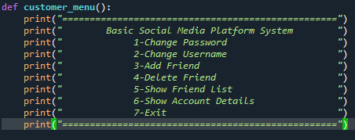
customer_menu():
Displays a menu for various actions in the social media platform system.
Options include changing password, changing username, adding a friend, deleting a friend, showing friend list, and showing account details.

Slide 5
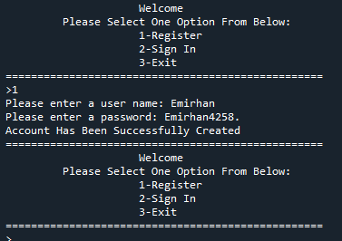
registration():
Prompts the user to enter a username and password for registration.
Performs validations on the password to ensure it meets the required criteria.
Checks if the username is already taken by another user.
Saves the account details, including username, password, and friend list, in a file.

Slide 6
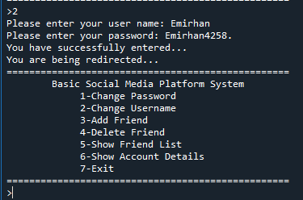
sign_in():
Prompts the user to enter their username and password.
Checks if the entered credentials match any existing account in the system.
Provides feedback on the success or failure of the sign-in process.

Slide 7
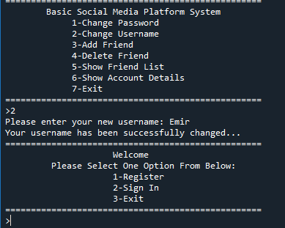
change_username():
Prompts the user to enter a new username for their account.
Checks if the new username is available (not already taken by another user).
Updates the account details in the file with the new username.

Slide 8
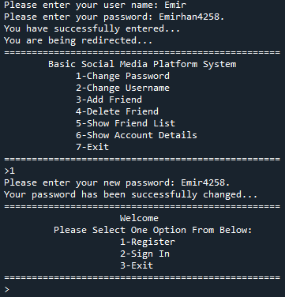
change_password():
Prompts the user to enter a new password for their account.
Performs validations on the new password to ensure it meets the required criteria.
Updates the account details in the file with the new password.

Slide 9
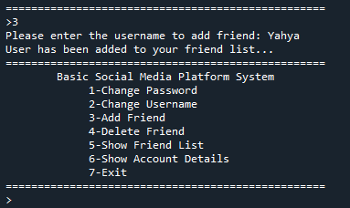
add_friend():
Prompts the user to enter the username of the friend they want to add.
Checks if the entered username exists and is not the user's own username.
Adds the friend to the user's friend list and updates the friend lists of both users in the account details file.

Slide 10
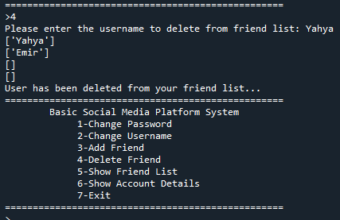
del_friend():
Prompts the user to enter the username of the friend they want to delete.
Checks if the entered username exists in the user's friend list.
Removes the friend from the user's friend list and updates the friend lists of both users in the account details file.

Slide 11
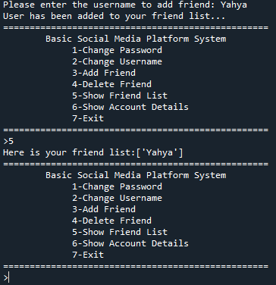
show_friend_list():
Retrieves the friend list of the user from the account details file.
Displays the friend list to the user.

Slide 12
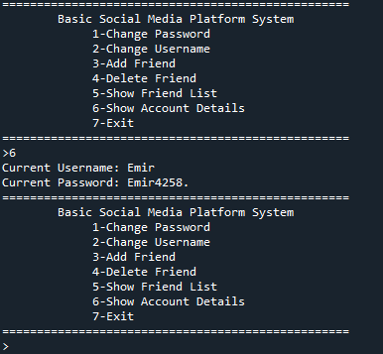
show_account_details():
Displays the user's account details.
Retrieves account information from the file containing the user's username and password.
Shows account details to the user.

